Slide 1

Chapter 3: Communicating in Organizational Groups and Teams
This multimedia product and its contents are protected under copyright law. The following are prohibited by law:
  any public performance or display, including transmission of any image over a network;
  preparation of any derivative work, including the extraction, in whole or in part, of any images;
  any rental, lease, or lending of the program.
Copyright © 2012, 2009, 2005 Pearson Education, Inc. All rights reserved.
Notes:
1

Slide 2
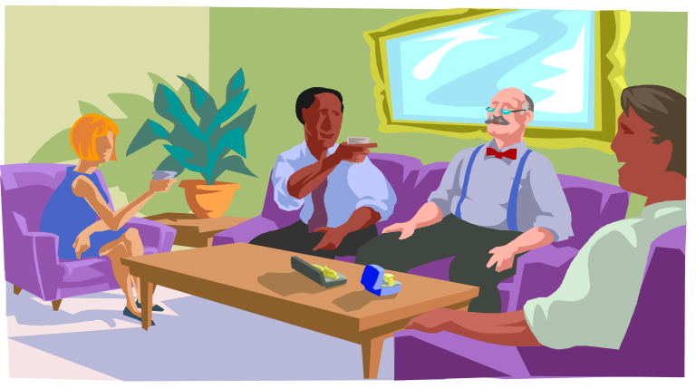
Definition of a Group
A group is a collection of three or more individuals who perceive themselves as a group, possess a common fate, and communicate with one another over time to accomplish both personal and group goals
Copyright © 2012, 2009, 2005 Pearson Education, Inc. All rights reserved.
Notes:
2

Slide 3

Self-Directed Teams
Teams have more decision authority than groups
Teams meet frequently to coordinate activity
Teams emphasize constant training and assessment
Copyright © 2012, 2009, 2005 Pearson Education, Inc. All rights reserved.
Notes:
3

Slide 4


Managers and Leaders
Role: An expectation about individual behavior patterns
Managers establish performance criteria, monitor and evaluate employees
Leaders define how issues are interpreted and induce members to transcend self-interest
Copyright © 2012, 2009, 2005 Pearson Education, Inc. All rights reserved.
Notes:
4

Slide 5
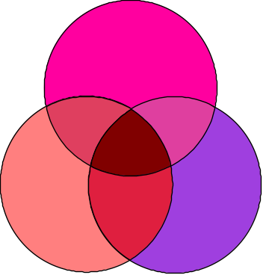

Managers and Leaders
Management: A contractual agreement whereby each person gives up something in order to get something else
Leadership: A consensual agreement whereby people share basic objectives and values
Exchange Contract
Area of Shared Agreement
Copyright © 2012, 2009, 2005 Pearson Education, Inc. All rights reserved.
Notes:
5

Slide 6
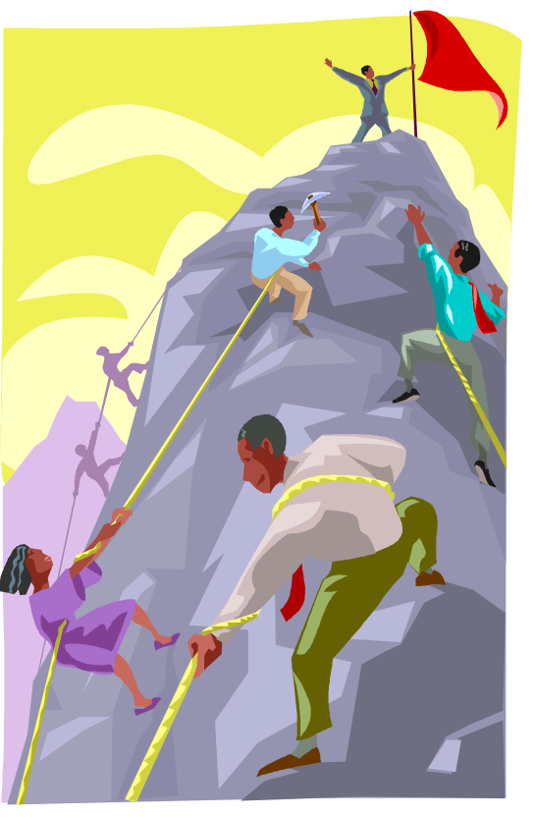
Leaders Organize the Team’s Work
Team activity is disorganized
Leaders use task, procedural, and interpersonal communication skills to help the team accomplish its goals
Copyright © 2012, 2009, 2005 Pearson Education, Inc. All rights reserved.
Notes:
6

Slide 7

Leaders Define the Team’s Focus
Charisma: The use of symbols to create a compelling vision
  Labels: Catchy symbols that describe an event
  Heroes: People that exemplify a vision
  Rituals: Events that mark milestones
  Identification: When members’ interests and goals overlap
    Praise
    Shared values
    Presumed “we”
    Common enemy
Copyright © 2012, 2009, 2005 Pearson Education, Inc. All rights reserved.
Notes:
7

Slide 8
Membership Competencies
Working Knowledge
Experience
Problem-Solving Ability
Copyright © 2012, 2009, 2005 Pearson Education, Inc. All rights reserved.
Notes:
8

Slide 9
Membership Competencies
Teamwork Factors
Openness
Personal Style
Supportiveness
Action Orientation
Copyright © 2012, 2009, 2005 Pearson Education, Inc. All rights reserved.

Slide 10

The Agenda Guides the Meeting
Solicit topics from members
Avoid scheduling oral reports
Include announcement, discussion, or decision items
Copyright © 2012, 2009, 2005 Pearson Education, Inc. All rights reserved.
Notes:
9

Slide 11
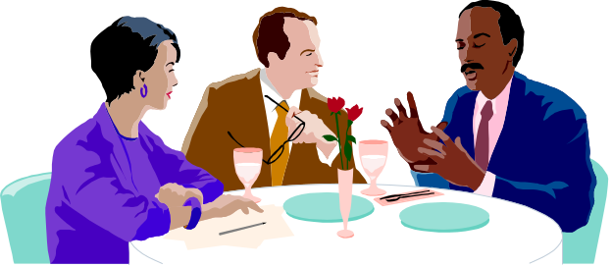
The Reflective Thinking Sequence
I. Define the Problem
II. Develop Criteria
III. List Solutions
IV. Select a Single Solution
V. Implement the Solution
Copyright © 2012, 2009, 2005 Pearson Education, Inc. All rights reserved.
Notes:
10

Slide 12
Defining the Problem
The definition of the problem influences the eventual solution
New Pool
Advertise
Declining Visitation
Good for Area
Speed Recovery
High Fees
Add Amenities
Copyright © 2012, 2009, 2005 Pearson Education, Inc. All rights reserved.
Notes:
11

Slide 13

Creativity
Novel
Relevant
Lateral and horizontal
Copyright © 2012, 2009, 2005 Pearson Education, Inc. All rights reserved.

Slide 14
Discussion Techniques
Brainstorming
Nominal Group Technique
Sensational Thinking
Morphological Analysis
Group Decision Support Systems (GDSS)
Copyright © 2012, 2009, 2005 Pearson Education, Inc. All rights reserved.
Notes:
12

Slide 15

Conflict in Groups and Teams
Conflict: The interaction of interdependent people who perceive incompatible goals and interference from each other in achieving those goals
Copyright © 2012, 2009, 2005 Pearson Education, Inc. All rights reserved.
Notes:
13

Slide 16
Groupthink
Groupthink: Occurs in teams that are so cohesive and lacking in conflict that members cease critical thinking
Avoiding Groupthink:
  Encourage every member to critique proposals
  Leaders must evaluate ideas
  Leaders should seek idea evaluation from other members
Copyright © 2012, 2009, 2005 Pearson Education, Inc. All rights reserved.
Notes:
14

Slide 17




Competing and Avoiding
Competing:
  High assertiveness
  Low cooperativeness
Avoiding:
  Low assertiveness
  Low cooperativeness
Copyright © 2012, 2009, 2005 Pearson Education, Inc. All rights reserved.
Notes:
15

Slide 18

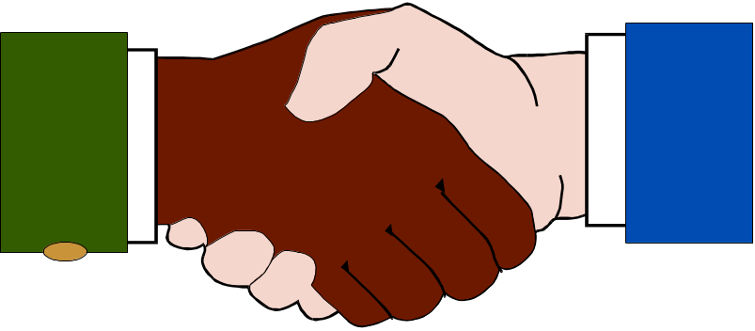
Accommodating and Compromising
Accommodating:
  High cooperativeness
  Low assertiveness
Compromising:
  Moderate assertiveness
  Moderate cooperativeness
Copyright © 2012, 2009, 2005 Pearson Education, Inc. All rights reserved.
Notes:
16

Slide 19

Problem-solving
Problem-Solving:
  High assertiveness
  High cooperativeness
Copyright © 2012, 2009, 2005 Pearson Education, Inc. All rights reserved.
Notes:
17

Slide 20
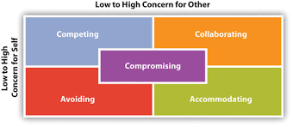
Conflict Styles (Thomas-Kilman)

Slide 21
Which animal are you?
http://slideplayer.com/slide/5259596/

Slide 22

Five Phase Model of Conflict Resolution
Introduction
Explanation
Clarifying
Problem-Solving
Resolution
Copyright © 2012, 2009, 2005 Pearson Education, Inc. All rights reserved.
Notes:
18

